Slide 1
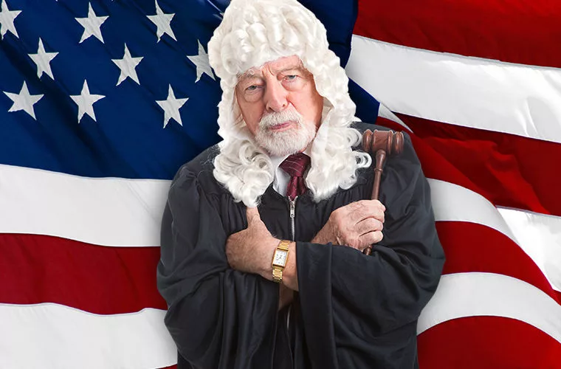
unusual laws of America
Филиал государственного образовательного учреждения высшего образования Московской области «Государственного социально-гуманитарного университета» в г. Зарайске – Зарайский педагогический колледж
Prepared:
4th year students of group «F»
Kovaleva A.V.,
Dzhegaltsova Y.S.
Teacher: Minaeva R.V.
Zaraysk
2023

Slide 2
In Alabama, you can't drive with your eyes closed and barefoot.

Slide 3
In the state of Alaska, it is illegal to give alcohol to a moose because one day the moose drank some beer from a local brewery and made a mess.

Slide 4
In the state of Arkansas, you can't bring flamingos to barbershops.
+
=

Slide 5
In Vermont, a woman can wear false teeth only with the written permission of her husband.

Slide 6
In Illinois, you can't hum a song to yourself if you're outside on a Sunday.

Slide 7
In Iowa, it is illegal to kiss for more than five minutes.
>

Slide 8
In West Virginia, living together outside of marriage can result in up to 1 year in prison, as for debauchery.

Slide 9
In California, peacocks are the first to cross the street.

Slide 10
In Colorado, it is illegal to kiss a sleeping woman.

Slide 11
In Louisiana, it is illegal to make gurgling sounds in public places.

Slide 12
Quiz
1. How can I not drive a car in Alabama?
2. Why is it forbidden to give alcohol to moose in Alaska?
3. Who can't be brought to hairdressers in Arkansas?
4. Who allows women to wear false teeth in Vermont?
5. How many minutes can you kiss in Iowa?
6. Who has the right to pass first in California when crossing the street?
7. Who is forbidden to kiss in Colorado?
8. What sounds should not be made in public places in the state of Louisiana?

Slide 13
Answers
1. Barefoot and with closed eyes.
2. Because one day a moose drank some beer from a local brewery and made a mess.
3. Flamingos.
4. Husband.
5. No more than 5 minutes.
6. Peacocks.
7. A sleeping woman.
8. Gurgling sounds.

Slide 14
Task
Find Russian equivalents to the following American proverbs and sayings.

Slide 15
American proverbs and sayings
Russian equivalents
Вы должны поцеловать много жаб, прежде чем найти красивого принца.
Немножко поздно – это слишком поздно.
Прежде чем занять у друга деньги, подумай, что тебе нужнее: друг или деньги.
Все лучшее в жизни бесплатно.
Если не сломалось – не чини.
Легче подавить первое желание, чем удовлетворить все последующие.
Вы никогда не знаете, что достаточно, пока вы не узнаете, что уже более чем достаточно.
A little too late is much too late.
If it ain’t broke, don’t fix it.
You have to kiss a lot of toads before you find a handsome prince.
The best things in life are free.
Before borrowing money from a friend it’s best to decide which you need most.
You never know what is enough unless you know what is more than enough.
It is easier to supress the first desire than to satisfy all those that follow.

Slide 16
Solve the puzzle
Across:
A man married to a woman.
Pink bird.
The day of the week between Saturday and Monday.
The place where men get their hair cut (plural).
Sounds that cannot be made in public places in the state of Louisiana.
In the state of Alaska, it is forbidden to give moose ...
Is it not true?
Down:
8. A synonym for the word "ridiculous“.
1
8
2
3
4
5
6
7

Slide 17
Answers

Slide 18
 |  |  |  |  | h | u | s | b | a | n | d
 | f | l | a | m | i | n | g | o | s
 |  |  |  |  | S | u | n | d | a | y
b | a | r | b | e | r | s | h | o | p | s
 |  |  |  |  | g | u | r | g | l | i | n | g
 |  |  |  |  |  | a | l | c | o | h | o | l
 |  |  |  | f | a | l | s | e
1
2
3
4
5
6
7

Slide 19
Solve the crossword about the states of America.

Slide 20
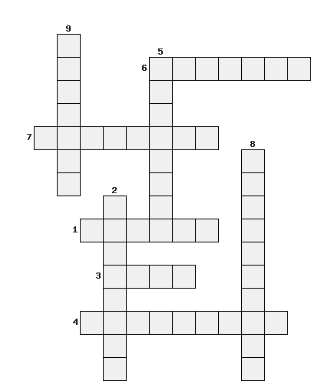
Across:
The largest state in the USA?
3. The "Hawkeye State«?
4. The state whose symbol is the brown pelican?
6. The state is the "Heart of the South"?
7. The state in which the Grand Canyon is located?
Down:
2. A state nicknamed "Lincoln Land" and "Prairie State"?
5. A state that has the world's only open diamond deposit?
8. The most populous state in America?
9. A state with its own graveyard of ice cream flavors?

Slide 21
Answers

Slide 22
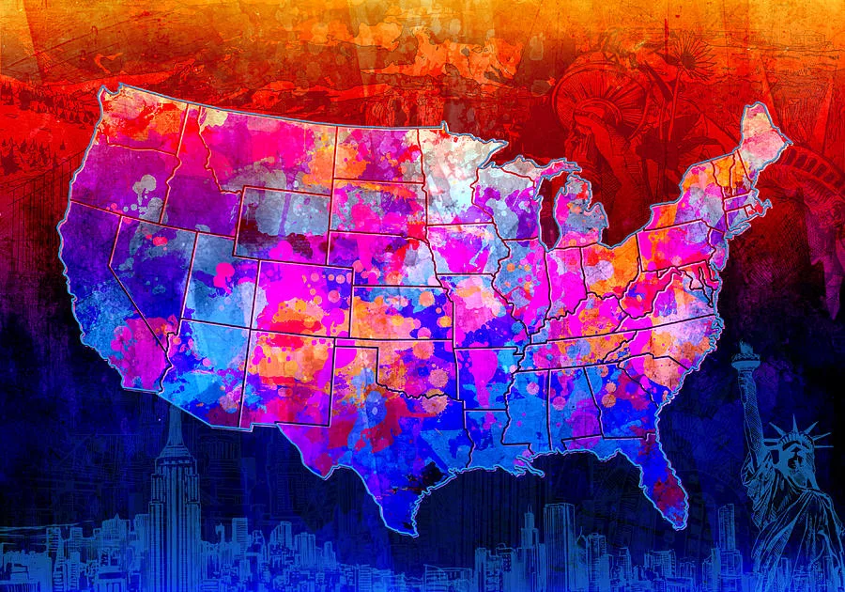

Slide 23
Find the 10 hidden symbols of US states.
b | a | d | i | n | o | s | a | u | r
h | u | e | j | d | k | l | x | m | s
f | f | t | m | g | o | d | n | o | p
i | w | q | t | j | r | d | n | x | m
s | h | b | f | e | p | g | h | d | i
h | o | d | s | n | r | m | a | z | n
a | r | e | w | o | l | f | v | b | e
d | s | b | y | i | s | k | l | p | r
z | e | i | n | s | e | c | t | y | a
t | s | g | b | i | r | d | w | p | l
бабочка
цветок
динозавр
лошадь
минерал
насекомое
песня
птица
рыба
собака

Slide 25
Literature
https://vk.com/away.php?to=https%3A%2F%2Fvc.ru%2Fu%2F1185930-moovert-way-to-usa%2F522591-nesuraznye-i-smeshnye-zakony-ssha&cc_key=
https://vk.com/away.php?to=https%3A%2F%2Fenglex.ru%2Ffunny-laws-of-the-usa%2F&cc_key=
https://fishki-net.turbopages.org/fishki.net/s/photo/3385926-50-smeshnyh-i-strannyh-zakonov-ssha.html

Slide 26
Pictures
https://yandex.ru/images/search?cbir_id=8277247%2F_OnyM_v_oUOH4uushmuY9Q5953&pos=0&rpt=imageview&img_url=http%3A%2F%2Fpoznavaemoe.ru%2Fupload%2Fiblock%2F410%2Fzapret-na-srezanie-birok-s-matrasov-i-drugie-duratskie-amerikanskie-zakony.jpg&from=tabbar&cbir_page=similar&url=https%3A%2F%2Favatars.mds.yandex.net%2Fget-images-cbir%2F8277247%2F_OnyM_v_oUOH4uushmuY9Q5953%2Forig
https://yandex.ru/images/search?cbir_id=1016365%2F3lge1-e9gZ11yGHIrETKLg5898&pos=0&rpt=imageview&img_url=http%3A%2F%2Fsomanyhorses.ru%2Fwp-content%2Fimages%2Fnews%2Favto-novosti%2F2020%2F9%2Fv-rossii-slepoy-na-oba-glaza-muzhchina-poluchil-voditelskie-prava%2F5f608b1003895_sle-4.jpg&from=tabbar&cbir_page=similar&url=https%3A%2F%2Favatars.mds.yandex.net%2Fget-images-cbir%2F1016365%2F3lge1-e9gZ11yGHIrETKLg5898%2Forig
https://yandex.ru/images/search?cbir_id=9581251%2FcI7tNmmM2BWtZ_Fo4RQVkA5996&pos=0&rpt=imageview&img_url=http%3A%2F%2Fkadara.ru%2Fwp-content%2Fuploads%2F2023%2F01%2F1-11.webp&from=tabbar&cbir_page=similar&url=https%3A%2F%2Favatars.mds.yandex.net%2Fget-images-cbir%2F9581251%2FcI7tNmmM2BWtZ_Fo4RQVkA5996%2Forig
https://yandex.ru/images/search?cbir_id=1687564%2FCODEGWdYQZ6WiYdUIM01jA6027&pos=0&rpt=imageview&img_url=http%3A%2F%2Ffikiwiki.com%2Fuploads%2Fposts%2F2022-02%2F1644918478_35-fikiwiki-com-p-kartinki-mi-protiv-alkogolya-38.jpg&from=tabbar&cbir_page=similar&url=https%3A%2F%2Favatars.mds.yandex.net%2Fget-images-cbir%2F1687564%2FCODEGWdYQZ6WiYdUIM01jA6027%2Forig
https://yandex.ru/images/search?cbir_id=9181281%2FH8ilvWkVrc2t7uZIyksX5Q6077&pos=0&rpt=imageview&img_url=http%3A%2F%2Fpofoto.club%2Fuploads%2Fposts%2F2022-08%2F1660837749_37-pofoto-club-p-severnii-rozovii-flamingo-43.jpg&from=tabbar&cbir_page=similar&url=https%3A%2F%2Favatars.mds.yandex.net%2Fget-images-cbir%2F9181281%2FH8ilvWkVrc2t7uZIyksX5Q6077%2Forig

Slide 27
Pictures
https://yandex.ru/images/search?cbir_id=8821558%2Fu9hUv7R30NqqWxDlzght1w6099&pos=0&rpt=imageview&img_url=http%3A%2F%2Feventus-stroy.ru%2Fwp-content%2Fgallery%2Fd181d0b0d0bbd0bed0bd-d0bad180d0b0d181d0bed182d18b-d0bcd0bed0b6d0b0d0b9d181d0bad0bed0b5-d188d0bed181d181d0b5-71%2F005.jpg&from=tabbar&cbir_page=similar&url=https%3A%2F%2Favatars.mds.yandex.net%2Fget-images-cbir%2F8821558%2Fu9hUv7R30NqqWxDlzght1w6099%2Forig
https://yandex.ru/images/search?cbir_id=9655963%2FqyqGUKut7vTRaNrMzjuIIA6126&pos=6&rpt=imageview&img_url=http%3A%2F%2Fmylnaya-opera.ru%2F5724-cart_default%2Fforma-3d-kamasutra-iv.jpg&from=tabbar&cbir_page=similar&url=https%3A%2F%2Favatars.mds.yandex.net%2Fget-images-cbir%2F9655963%2FqyqGUKut7vTRaNrMzjuIIA6126%2Forig
https://yandex.ru/images/search?cbir_id=9282074%2Fug22HVhe-wbCZLstLS0tdg6172&pos=0&rpt=imageview&img_url=http%3A%2F%2Fbiscaynedentalcenter.com%2Fwp-content%2Fuploads%2F2021%2F11%2Fdepositphotos_9289501_l-1-1536x1024.jpg&from=tabbar&cbir_page=similar&url=https%3A%2F%2Favatars.mds.yandex.net%2Fget-images-cbir%2F9282074%2Fug22HVhe-wbCZLstLS0tdg6172%2Forig
https://yandex.ru/images/search?url=https%3A%2F%2Favatars.mds.yandex.net%2Fget-images-cbir%2F8270106%2FWpRxqwrLrctvUPnBrPQEuA6245%2Forig&cbir_id=8270106%2FWpRxqwrLrctvUPnBrPQEuA6245&rpt=imageview&cbir_page=similar&from=tabbar&pos=0&img_url=http%3A%2F%2Fcdn.gigi.click%2Fdata%2Fupload%2FUID728242_1614857737_80.jpg
https://yandex.ru/images/search?url=https%3A%2F%2Favatars.mds.yandex.net%2Fget-images-cbir%2F1879261%2F09TQ_eOIeyOaQZ88cW3NfQ6315%2Forig&cbir_id=1879261%2F09TQ_eOIeyOaQZ88cW3NfQ6315&rpt=imageview&cbir_page=similar&from=tabbar&pos=0&img_url=http%3A%2F%2Frichardtulloch.files.wordpress.com%2F2011%2F09%2Fno-kissing-sign.jpg
https://yandex.ru/images/search?url=https%3A%2F%2Favatars.mds.yandex.net%2Fget-images-cbir%2F9626370%2Fyu_OTTKJbbj3QTjlXn4sjA6344%2Forig&cbir_id=9626370%2Fyu_OTTKJbbj3QTjlXn4sjA6344&rpt=imageview&cbir_page=similar&from=tabbar&pos=0&img_url=http%3A%2F%2Ftelegram.im%2Fimg%2Fbitime_kiev

Slide 28
Pictures
https://yandex.ru/images/search?url=https%3A%2F%2Favatars.mds.yandex.net%2Fget-images-cbir%2F1974051%2F0iyX3RNQnfTYV2nfkZJgYw6370%2Forig&cbir_id=1974051%2F0iyX3RNQnfTYV2nfkZJgYw6370&rpt=imageview&cbir_page=similar&from=tabbar&pos=0&img_url=http%3A%2F%2Fcspsid-pechatniki.ru%2F800%2F600%2Fhttps%2Fedinstvennaya.ua%2Fstorage%2Fshares%2Fuploads%2Ffiles%2Fshutterstock_583394326.jpg
https://yandex.ru/images/search?rpt=imageview&url=https%3A%2F%2Favatars.mds.yandex.net%2Fget-images-cbir%2F9069614%2Fgju0mDRJmRIo_1RYKNyJmw6474%2Forig&cbir_id=9069614%2Fgju0mDRJmRIo_1RYKNyJmw6474&source-serpid=gUE_sO3s0FGamf8vEOQixA&cbir_page=similar&from=tabbar&pos=33&img_url=http%3A%2F%2Fi1.imgiz.com%2Frshots%2F7546%2Fsaskin-tavus-kusu-halkin-arasin-da_7546392-00_1280x720.jpg
https://yandex.ru/images/search?rpt=imageview&url=https%3A%2F%2Favatars.mds.yandex.net%2Fget-images-cbir%2F9099069%2FmuyMSkwSILaCcWx0bKDq9g6523%2Forig&cbir_id=9099069%2FmuyMSkwSILaCcWx0bKDq9g6523&source-serpid=gUE_sO3s0FGamf8vEOQixA&cbir_page=similar&from=tabbar&pos=0&img_url=http%3A%2F%2Fimages.fanart.tv%2Ffanart%2Fsleeping-beauty-55199ef352baa.jpg
https://yandex.ru/images/search?rpt=imageview&url=https%3A%2F%2Favatars.mds.yandex.net%2Fget-images-cbir%2F9112074%2FH4SetRmRpgvPwMM2fRK2OA6552%2Forig&cbir_id=9112074%2FH4SetRmRpgvPwMM2fRK2OA6552&source-serpid=gUE_sO3s0FGamf8vEOQixA&cbir_page=similar&from=tabbar&pos=0&img_url=http%3A%2F%2Fkc.lipetskddo.ru%2Fsites%2Fdefault%2Ffiles%2Fljki.jpg
https://yandex.ru/images/search?rpt=imageview&url=https%3A%2F%2Favatars.mds.yandex.net%2Fget-images-cbir%2F964020%2Fth8F71w9DSSsvACRmnSwJw6581%2Forig&cbir_id=964020%2Fth8F71w9DSSsvACRmnSwJw6581&source-serpid=gUE_sO3s0FGamf8vEOQixA&cbir_page=similar&from=tabbar&pos=0&img_url=http%3A%2F%2Fpaintingvalley.com%2Fimages%2Funited-states-painting-23.jpg

Slide 29
Pictures
https://yandex.ru/images/search?rpt=imageview&url=https%3A%2F%2Favatars.mds.yandex.net%2Fget-images-cbir%2F8289055%2F6bRcc4eiJ_i8nGOzurFaiQ6608%2Forig&cbir_id=8289055%2F6bRcc4eiJ_i8nGOzurFaiQ6608&source-serpid=gUE_sO3s0FGamf8vEOQixA&cbir_page=similar&from=tabbar&pos=0&img_url=http%3A%2F%2Fkak2z.ru%2Fmy_img%2Fimg%2F2022%2F11%2F12%2Fd77c9.gif

